Slide 1
Module 3
Stack Structure of 8086

Slide 2
SP is 16-bit register that points to top of stack
Lies in the SS
SS may have a memory block of a max of 64 Kbyte locations
Stack seg register (SS) contains the base address of the stack seg in the memory
SS and SP together address the stack-top

Slide 3
Let SS =5000H, SP= 2050H .Find current stack top address?

Slide 4
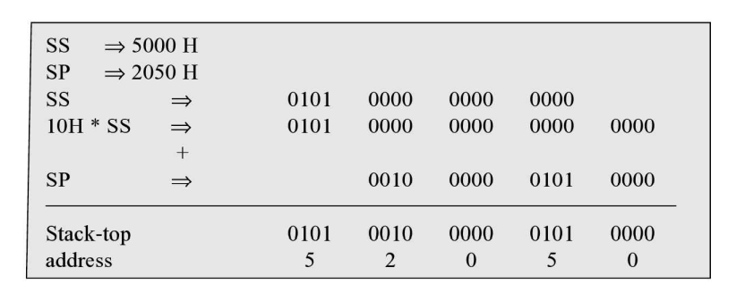

Slide 5
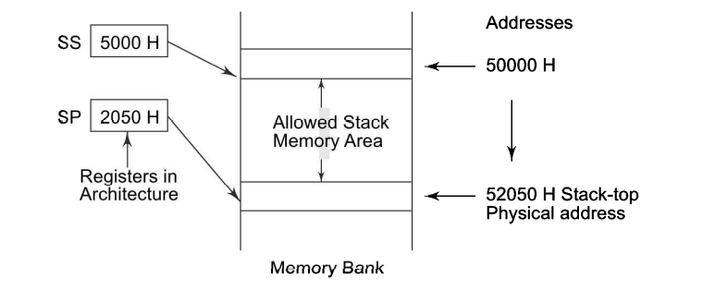

Slide 6
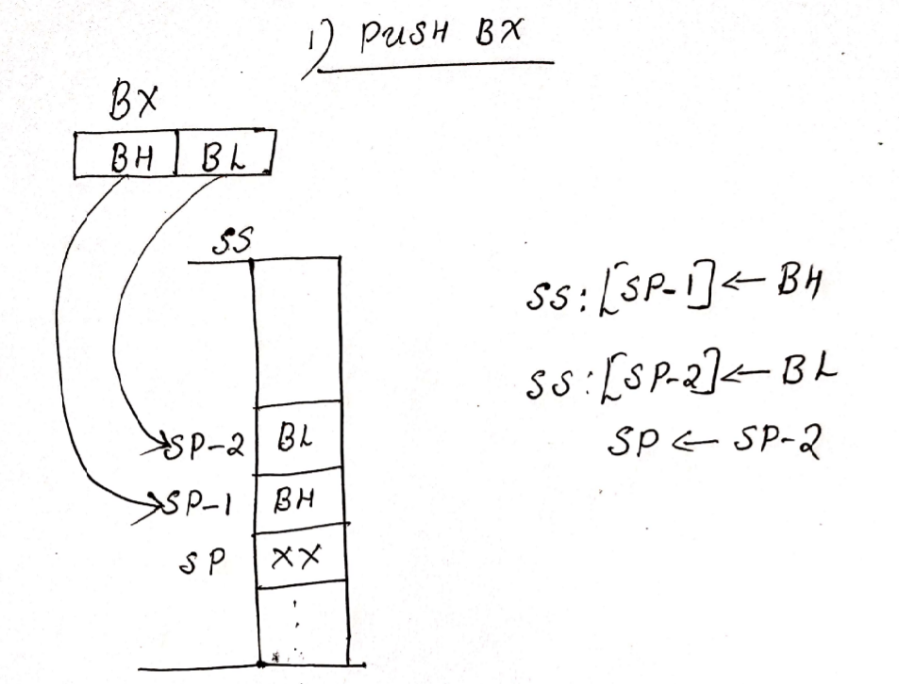
PUSH BX

Slide 7
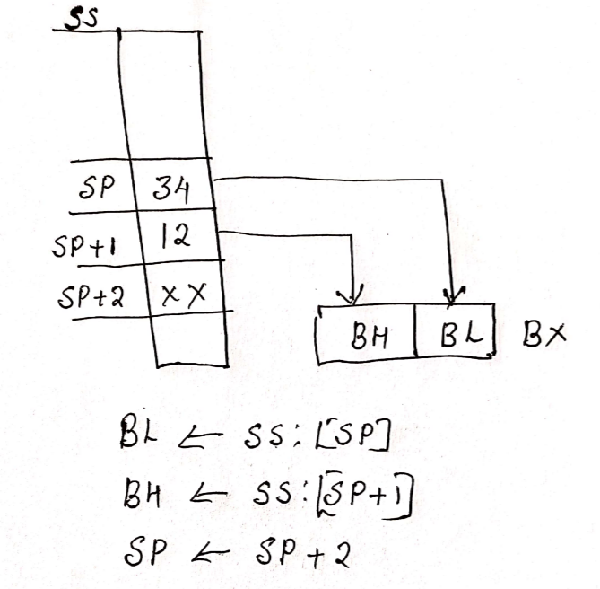
POP BX

